Slide 1
CS 331
Topic: Advanced File and I/O Operations Part 2
Exceptions and Templates Part 1
MD Romael Haque

Slide 2
Member Functions for Reading and Writing Files
File stream objects have member functions for more specialized file reading and writing.
If whitespace characters are part of the information in a file, a problem arises when the file is read by the >> operator.
Since the operator considers whitespace characters as delimiters, it does not read them.

Slide 3
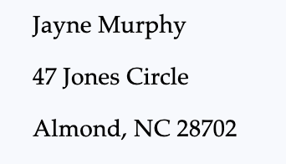
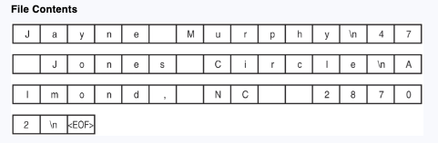
Member Functions for Reading and Writing Files
For example, consider the file murphy.txt that contains the following information:
The following figure shows the way the information is recorded in the file.

Slide 4
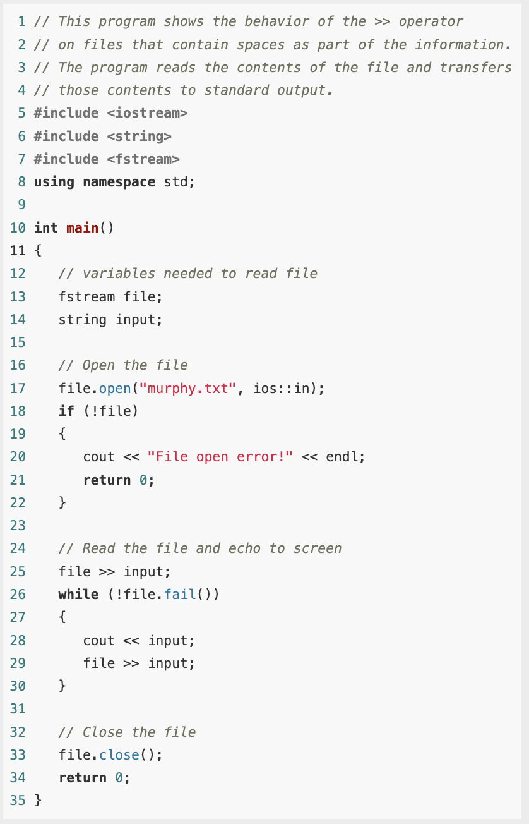
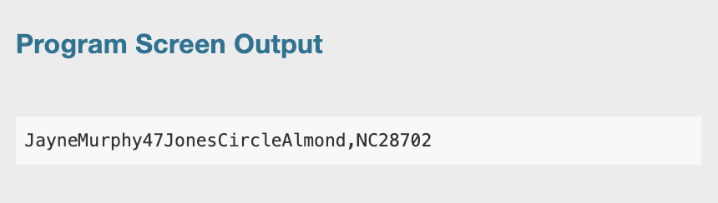
Member Functions for Reading and Writing Files
The problem that arises from use of the >> operator is evident in the output of this example

Slide 5
The getline function
One way to get around the problem in previous example is to use a function that reads an entire line of text.
There is a global function that is part of the string library that you can use for this purpose:

Slide 6
The getline function
This function reads a line of text from a stream is and stores it into a string variable str.
The function has an optional parameter delim that marks the end of the line to be read.
The delimiting character is removed from the stream and discarded.
If getline is called without the third parameter, the delimiter is assumed to be the end of line character '\n'.

Slide 7
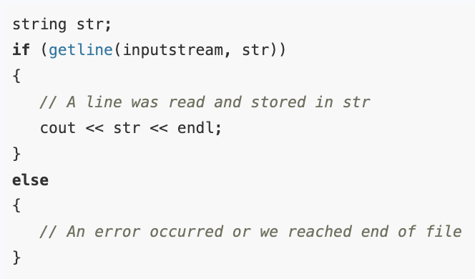
The getline function
The first parameter, is, must be an object of the class istream.
It can also be any object of the classes istringstream, ifstream, or fstream (if an fstream object is passed, it must have been opened for input).
The value returned is a reference to the input stream that was just read.
This allows the return value to be tested to ascertain the success or failure of the call as in this code fragment:

Slide 8
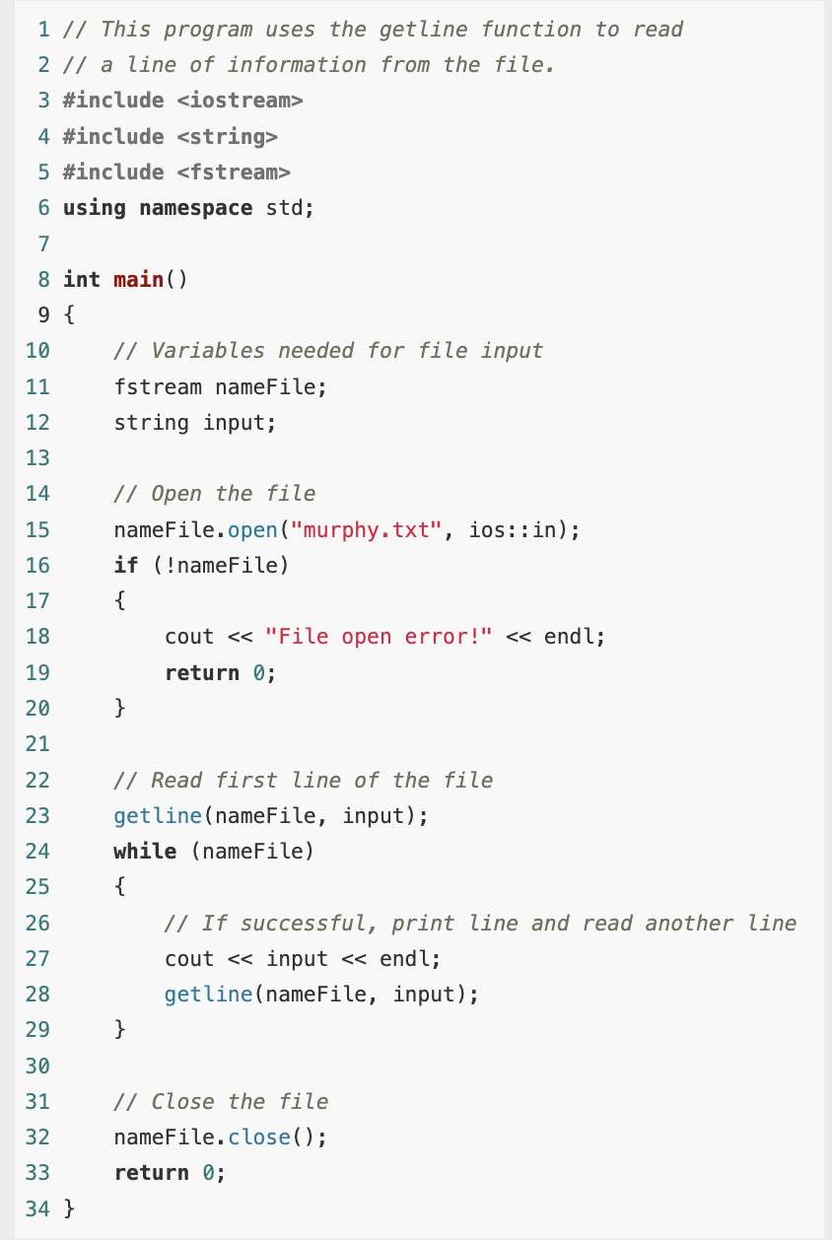
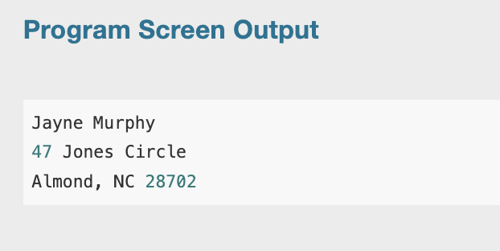
Example

Slide 9

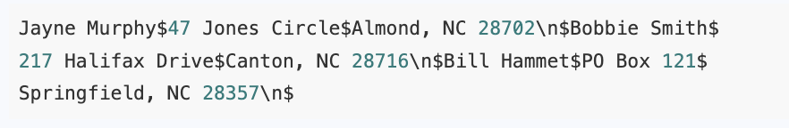
The getline function
Because the third argument of the getline function was left out in previous example, its default value is \n.
Sometimes you might want to specify another delimiter.
For example, consider a file that contains multiple names and addresses internally formatted in the following manner:

Slide 10
The getline function
Think of this file as consisting of three records.
A record is a complete set of information about a single item.
Also, the records in the file are made of three fields.
The first field is the person’s name.
The second field is the person’s street address or PO box number.
The third field contains the person’s city, state, and ZIP code.
Notice that each field ends with a $ character, and each record ends with a \n character.

Slide 11
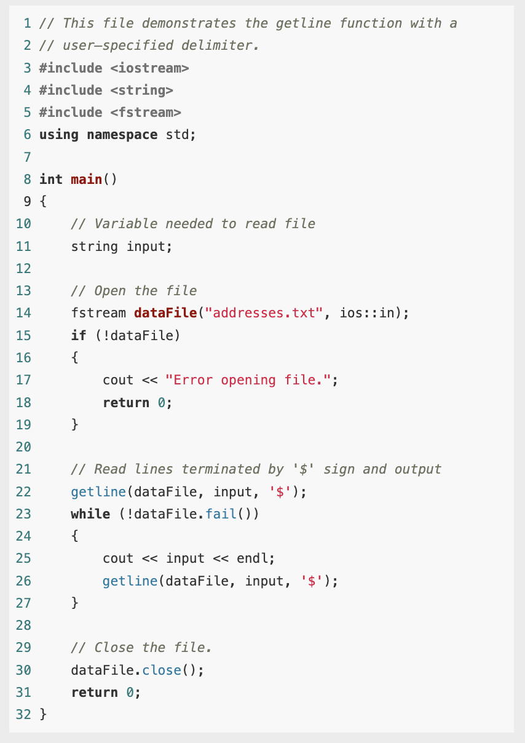
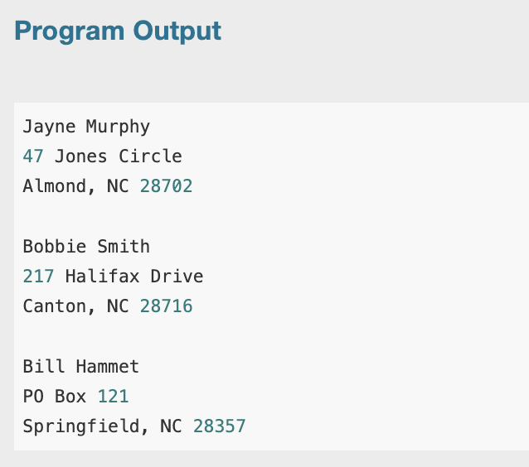
The getline function
In this example we used getline function to detect the $ characters.

Slide 12
The getline function
Notice that the \n characters, which mark the end of each record, are also part of the output.
They cause an extra blank line to be printed on the screen, separating the records.
When using a printable character such as $ to delimit information in a file, be sure to select a character that will not actually appear in the information itself.
Since it’s doubtful that anyone’s name or address contains a $ character, it’s an acceptable delimiter.
If the file contained dollar amounts, however, another delimiter would have been chosen.

Slide 13

The get Family of Member Functions
Each of the input classes ifstream , fstream , and istringstream has a family of get member functions that can be used to read single characters:
The first version reads a single character.
If successful, it returns an integer code representing the character that was read.
If unsuccessful, it sets the error codes on the stream and returns the special value EOF

Slide 14
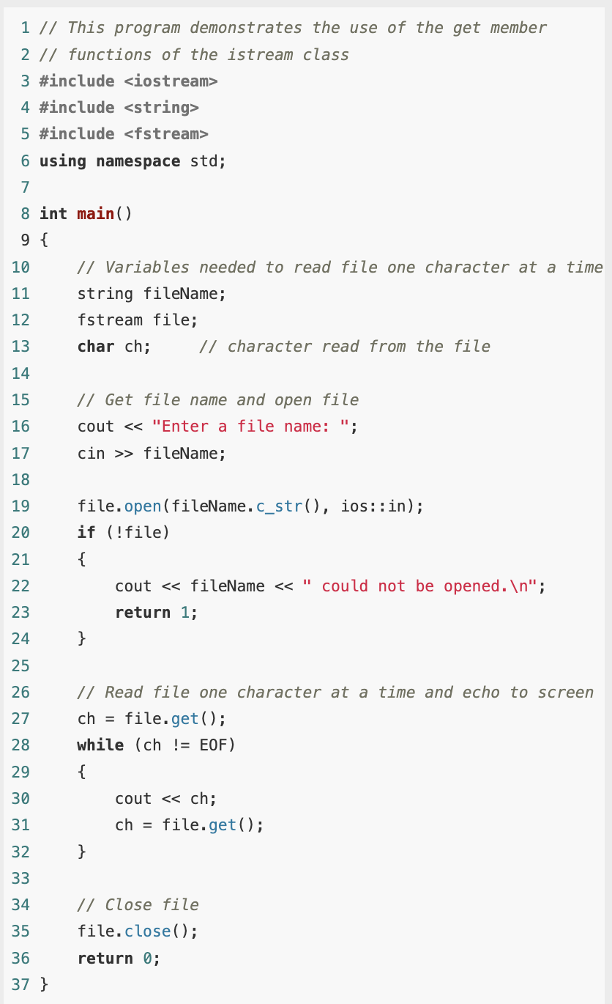
Example
This program will display the contents of any file.
Because the get function does not skip whitespaces, all the characters will be shown exactly as they appear in the file.

Slide 15
The peek Member Function
The peek member function is similar to get, but there is an important difference.
When the get function is called, it returns the next character available from the input stream and removes that character from the stream.
In contrast, the peek function returns a copy of the next character available without removing it from the stream.
Thus, get()reads a character from the file, but peek() just “looks” at the next character without actually reading it.

Slide 16
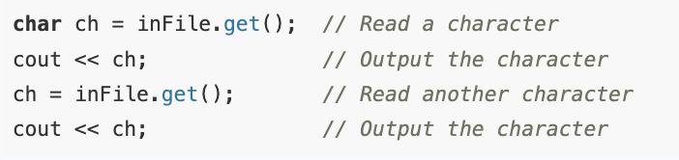
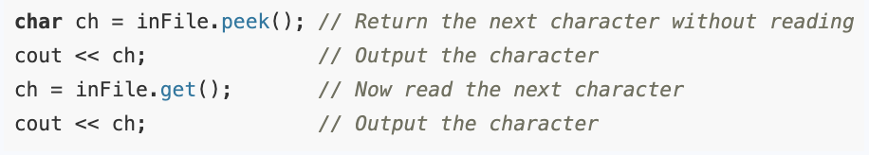
The peek Member Function
To see the difference, suppose that a newly opened file contains the string "abc".
Then the sequence of statements will print the two characters "ab" on the screen.
However, the statements will print the two characters "aa" on the screen.

Slide 17
The peek Member Function
The peek function is useful when you need to know what kind of data you are about to read before you actually read it, so you can decide on the best input method to use.
If the data is numeric, it is best read with the stream extraction operator >>, but if the data is a non-numeric sequence of characters, then it should be read with get or getline.

Slide 18
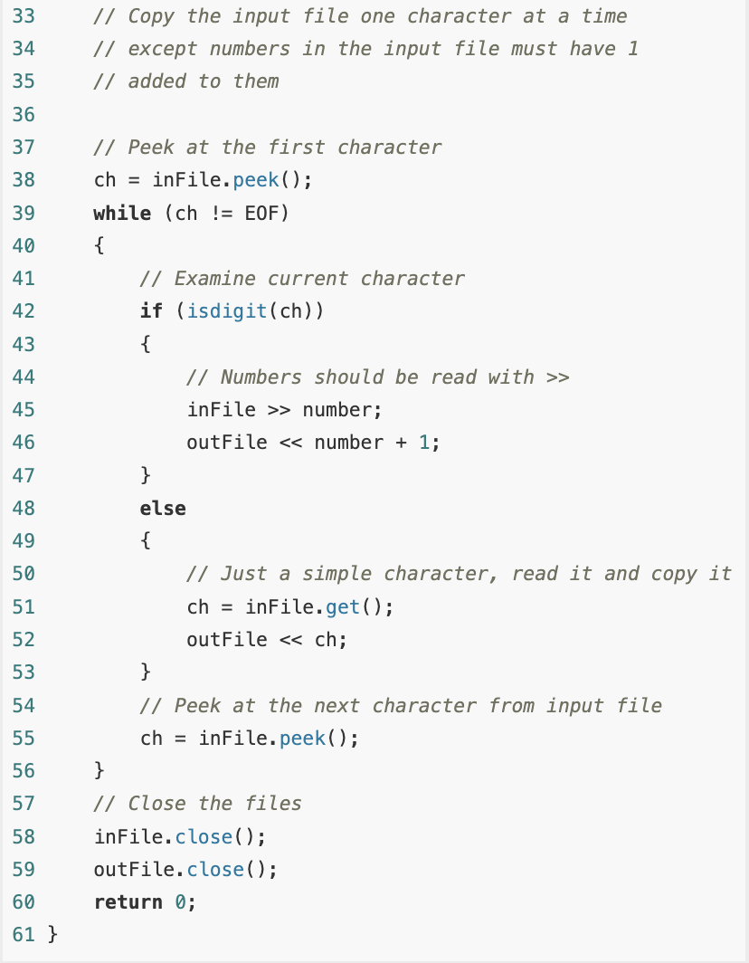
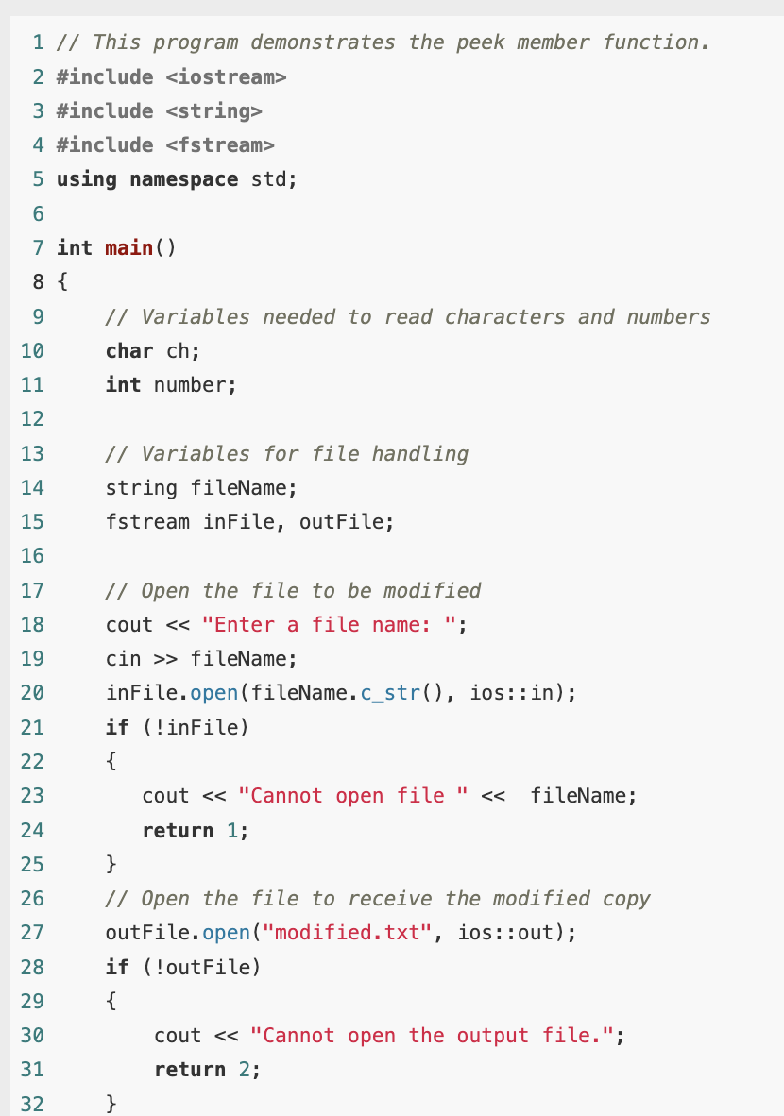
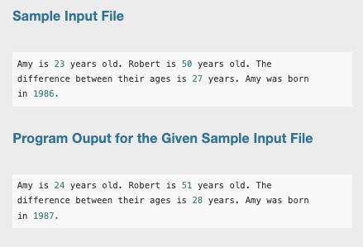
Example

Slide 19
The peek Member Function
The program cannot tell beforehand whether the next character to be read is a digit that starts a number (in which case the entire number should be read using the stream extraction operator >>) or just an ordinary nondigit character (in which case the character should be read using a call to the get() member function).
The program therefore uses peek() to examine characters without actually reading them (lines 38 and 55).
If a character is a digit, the extraction operator is called to read the number that starts with that character (lines 44–46).
Otherwise, the character is read using a call to get() (lines 50–52) and copied to the target file.

Slide 20
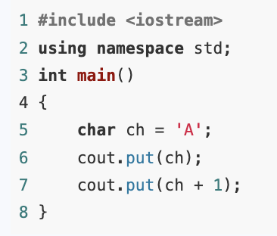
The put Member Function
Each of the output stream classes ofstream, fstream, and ostringstream has a member function that takes the integer code of a character and writes the corresponding character to the stream.
ostream& put(int c);
You can think of put as the output stream counterpart to the input stream get functions.
As an example, the following simple program prints AB on the screen.

Slide 21
Rewinding a File
Many times it is useful to open a file, process all the data in it, rewind the file back to the beginning, and process it again, perhaps in a slightly different fashion.
For example, a user may ask the program to search a database for all records of a certain kind, and when those are found, the user may want to search the database for all records of some other kind.
File stream classes offer a number of different member functions that can be used to move around in a file.

Slide 22
Rewinding a File
One such method is the member function of the input stream classes is seekg
The file “seeks” to a certain place in the file; the ‘g’ is for “get” and denotes that the function works on an input stream, because we “get” data from an input stream.
seekg(offset, place);

Slide 23
Rewinding a File
seekg(offset, place);
The new location in the file to seek to is given by the two parameters: the new location is at an offset of offset bytes from the starting point given by place.
The offset parameter is a long integer, while place can be one of three values defined in the ios class.
The starting place may be the beginning of the file, the current place in the file, or the end of the file.
These places are indicated by the constants ios:beg, ios::cur, and ios::end, respectively.

Slide 24

Rewinding a File
To move to the beginning of a file, use the call to move 0 bytes relative to the beginning of the file.
seekg(0L, ios::beg);
If you are already at the end of the file, you must clear the end of file flag before calling this function.
Thus, to move to the beginning of a file stream dataIn that you have just read to the end, you need the two statements

Slide 25
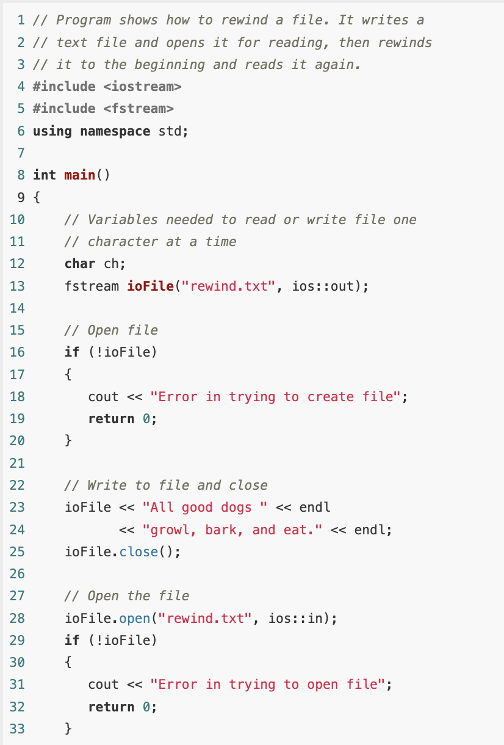
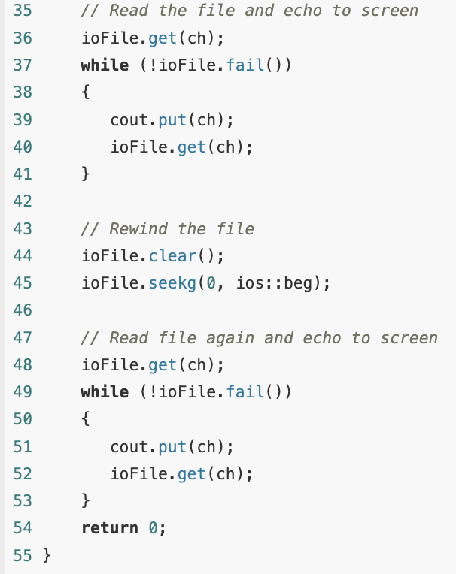
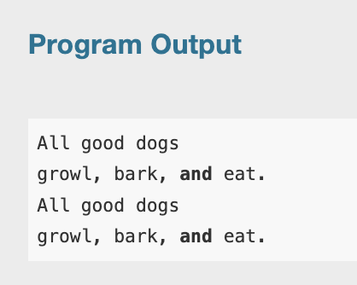
Example

Slide 26
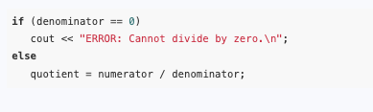
Exceptions
Error testing is usually a straightforward process involving if statements or other control mechanisms.
For example, the following code segment will trap a division-by-zero error before it occurs:

Slide 27
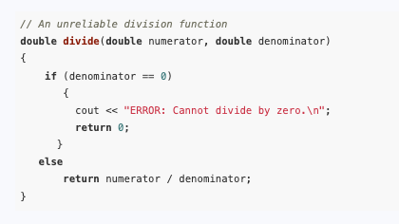
Exceptions
But what if similar code is part of a function that returns the quotient as in the following example:

Slide 28
Exceptions
Functions commonly signal error conditions by returning a predetermined value.
In this example, the function returns 0 when division by zero has been attempted.
This is unreliable, however, because 0 is a valid result of a division operation.
Even though the function displays an error message, the part of the program that calls the function will not know when an error has occurred.
Problems like these require more sophisticated error-handling techniques.

Slide 29
Throwing an Exception
One way of handling complex error conditions is with exceptions.
An exception is a value or an object that signals an error.
When the error occurs, an exception is said to be “thrown” because control will pass to a part of the program that catches and handles that type of error.

Slide 30
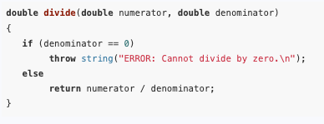
Throwing an Exception
For example, the following code shows the divide function, modified to throw an exception when division by zero has been attempted.

Slide 31

Throwing an Exception
The following statement causes the exception to be thrown.
The throw key word is followed by an argument, which can be any value.
As you will see, the type of the argument is used to determine the nature of the error.
The function above simply throws a string object containing a descriptive error message.

Slide 32
Throwing an Exception
The line containing a throw statement is known as the throw point.
When a throw statement is executed, control is passed to another part of the program known as an exception handler

Slide 33
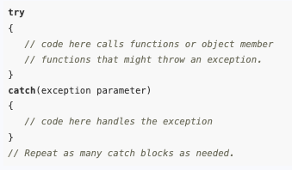
Handling an Exception
To handle an exception, a program must have a try/catch construct.
The general format of the try/catch construct is:

Slide 34
Handling an Exception
The first part of the construct is the try block.
This starts with the key word try and is followed by a block of code executing any statements that might directly or indirectly cause an exception to be thrown.
The try block is immediately followed by one or more catch blocks, which are the exception handlers.
A catch block starts with the key word catch, followed by a set of parentheses containing the declaration of an exception parameter.

Slide 35
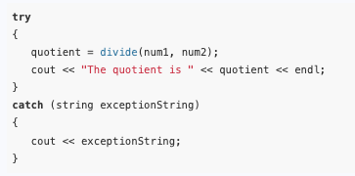
Handling an Exception
Here is a try/catch construct that can be used with the divide function:
Because the divide function throws an exception whose type is a string, there must be an exception handler that catches a string.
The catch block shown catches the error message in the exceptionString parameter, then displays it with cout.

Slide 36
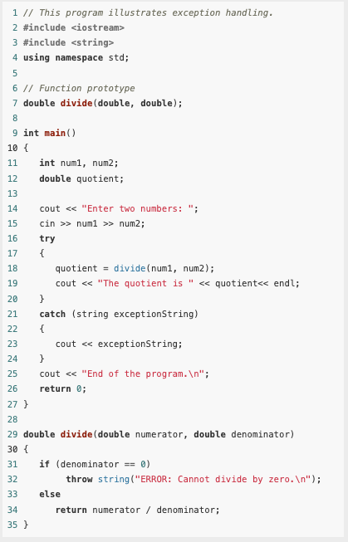
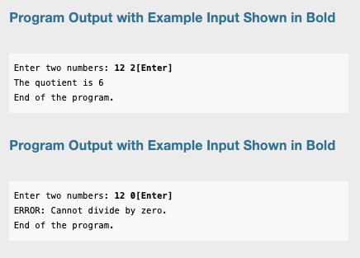
Complete example

Slide 37
What If an Exception Is Not Caught?
There are two possible ways for a thrown exception to go uncaught.
The first possibility is for the program to contain no catch blocks with an exception parameter of the right data type.
The second possibility is for the exception to be thrown from outside a try block.
In either case, the exception will cause the entire program to abort execution.

Slide 38
Object-Oriented Exception Handling with Classes
Now that you have an idea of how the exception mechanism in C++ works, we will examine an object-oriented approach to exception handling.

Slide 39
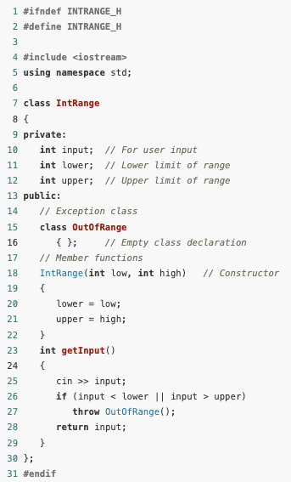
Object-Oriented Exception Handling with Classes
IntRange is a simple class whose member function, getInput, lets the user enter an integer value.
The value is compared against the member variables lower and upper (which are initialized by the class constructor).
If the value entered is less than lower or greater than upper, an exception is thrown indicating the value is out of range.
Otherwise, the value is returned from the function.
Instead of throwing a string or some value of a primitive type, this function throws an exception class.

Slide 40


Object-Oriented Exception Handling with Classes
Notice the empty class declaration that appears in the public section:
The only important part of this class is its name, which will be used by the exception-handling code.
Look at the if statement in the getinput function:

Slide 41

Object-Oriented Exception Handling with Classes
The throw statement’s argument, OutOfRange(), causes an instance of the OutOfRange class to be created and thrown as an exception.
All that remains is for a catch block to handle the exception.
Since the OutOfRange class is declared in the IntRange class, its name must be fully qualified with the scope resolution operator

Slide 42
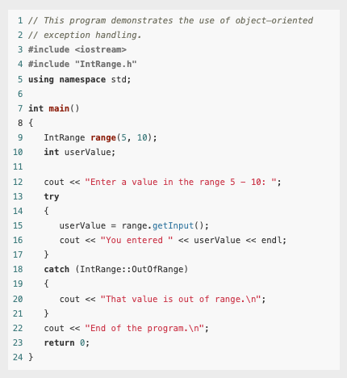
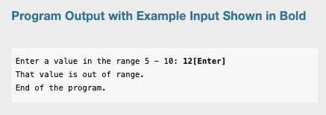
Main()

Slide 43
Multiple Exceptions
The programs we have studied so far test only for a single type of error and throw only a single type of exception.
In many cases, a program will need to test for several different types of errors and signal which one has occurred.
C++ allows you to throw and catch multiple exceptions.
The only requirement is that each different exception be of a different type.
You then code a separate catch block for each type of exception that may be thrown in the try block.

Slide 44
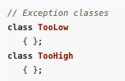
Multiple Exceptions
For example, suppose we wish to expand the IntRange class so that it throws one type of exception if the user enters a value that is too low, and another type if the user enters a value that is too high.
First, we declare two different exception classes, such as
An instance of the TooLow class will be thrown when the user enters a low value, and an instance of the TooHigh class will be thrown when a high value is entered.

Slide 45

Multiple Exceptions
Now, we modify the getInput member function to perform the two error tests and throw the appropriate exception:

Slide 46
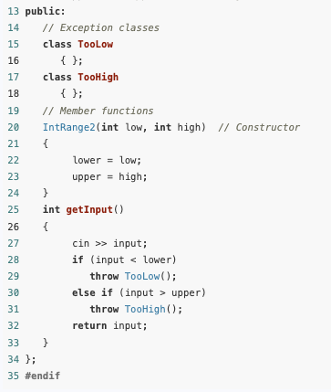
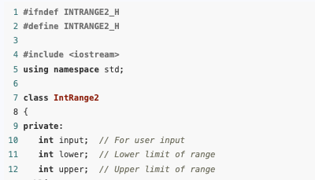
Contents of IntRange2.h

Slide 47
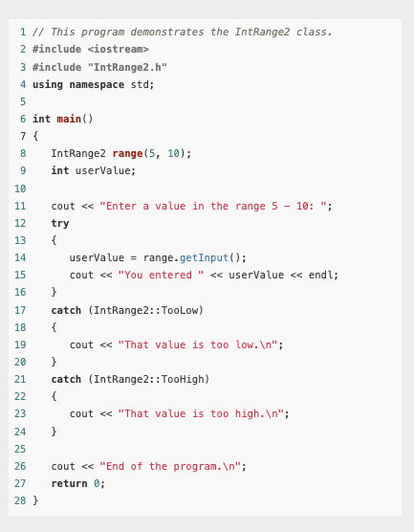
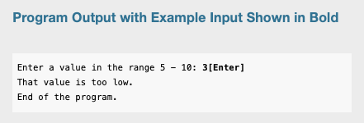
Main()

Slide 48
Extracting Information from the Exception Class
Sometimes we might want an exception to pass information back to the exception handler.
For example, suppose we would like the IntRange class not only to signal when an invalid value has been entered, but to pass the value back.
This can be accomplished by giving the exception class members in which information can be stored

Slide 49
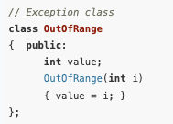
Extracting Information from the Exception Class
IntRange3, our next modification of the IntRange class, again uses a single exception class: OutOfRange.
This version of OutOfRange, however, has a member variable and a constructor that initializes it:

Slide 50
Extracting Information from the Exception Class
When we throw this exception, we want to pass the value entered by the user to the OutOfRange’s constructor.
This is done with the following statement:
This throw statement creates an instance of the OutOfRange class and passes a copy of the input variable to the constructor.
The constructor then stores this number in OutOfRange’s member variable value.
The class instance carries this member variable to the catch block that intercepts the exception.

Slide 51
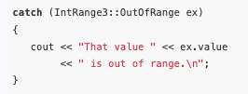
Extracting Information from the Exception Class
Back in the catch block, the value is extracted:
Notice that the catch block declares a parameter object named ex.
This is necessary because the exception has a member variable that we want to examine.

Slide 52
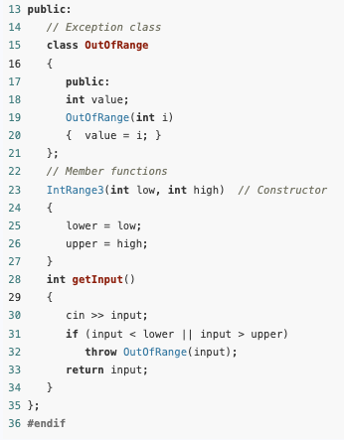
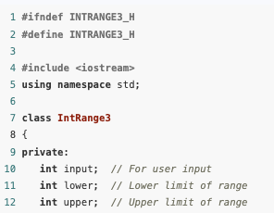
Contents of IntRange3.h

Slide 53
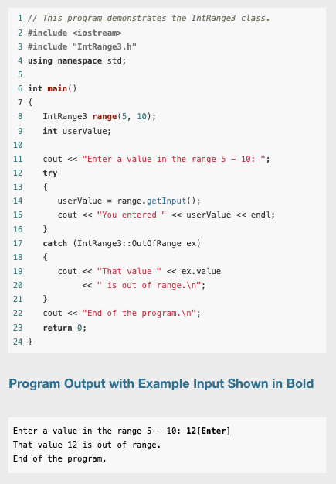
Main()

Slide 54
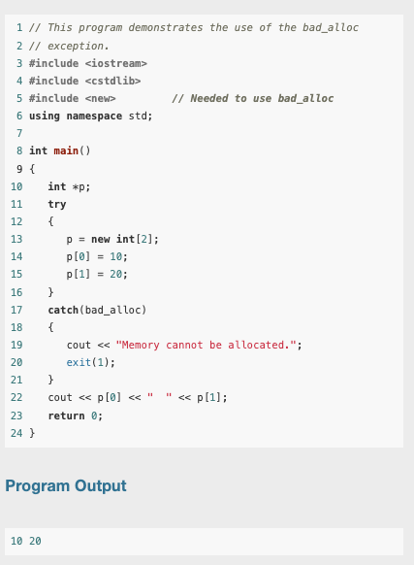
Handling the bad_alloc Exception Thrown by new
The new operator throws a system-defined exception of type bad_alloc if it is unable to allocate the requested storage.
For example, this program attempts to allocate an array of two integers using the new operator inside a try block.

Slide 55
Handling the bad_alloc Exception Thrown by new
If the allocation fails, the resulting bad_alloc exception is caught in the attached catch block and the program is terminated with an appropriate error message.
If the allocation succeeds, the program proceeds to print the two numbers 10 and 20.
The bad_alloc type is defined in the header file new, which must be included in programs that refer to it.

Slide 56
Unwinding the Stack
If an exception is thrown in a try block that has a catch block capable of handling the exception, control transfers from the throw point to the catch block.
Assuming that the catch block executes to completion without throwing further exceptions, returning from the function, or terminating the program, execution will continue at the first statement after the sequence of catch blocks attached to the try block.

Slide 57
Unwinding the Stack
If the function does not contain a catch block capable of handling the exception, control passes out of the function, and the exception is automatically rethrown at the point of the call in the calling function.
By this process, an exception can propagate backwards along the chain of function calls until the exception is thrown out of a try block that has a catch block that can handle it.
If no such try block is ever found, the exception will eventually be thrown out of the main function, causing the program to be terminated.
This process of propagating uncaught exceptions from a function to its caller is called unwinding the stack of function calls.

Slide 58
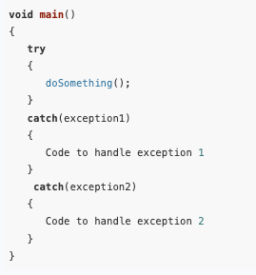
Rethrowing an Exception
It is possible for try blocks to be nested.
For example, look at this code segment:
In this try block, the function doSomething is called.
There are two catch blocks, one that handles exception1 and another that handles exception2.
If the doSomething function contains a try block, then it is nested inside the one shown.

Slide 59
Rethrowing an Exception
With nested try blocks, it is sometimes necessary for an inner exception handler to pass an exception to an outer exception handler.
Sometimes, both an inner and an outer catch block must perform operations when a particular exception is thrown.
These situations require that the inner catch block rethrow the exception so the outer catch block can catch it.

Slide 60
Rethrowing an Exception
A catch block can rethrow an exception with the throw; statement with no parameter.
For example, suppose the doSomething function (called in the try block above) executes code that potentially can throw exception1 or exception3.
Suppose we do not want to handle the exception1 error in doSomething, but instead want to rethrow it to the outer block

Slide 61
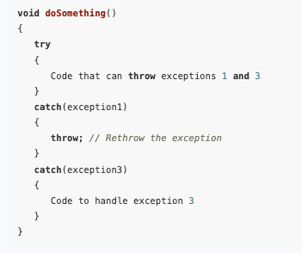
Rethrowing an Exception
When the first catch block catches exception1, the throw; statement simply throws the exception again.
The catch block in the outer try/catch construct, in this case the one in the main function, will then handle the exception.

